Slide 1
Exercise, Hippocampus and their role in Stress
Neeraj Kumar Tiwari
10-20-2017
Notes:
-

Slide 2
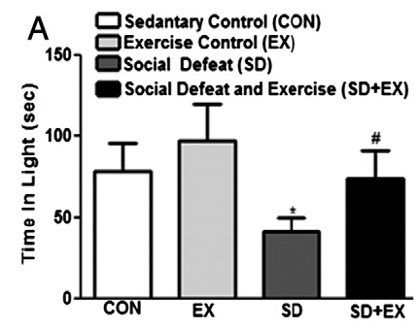
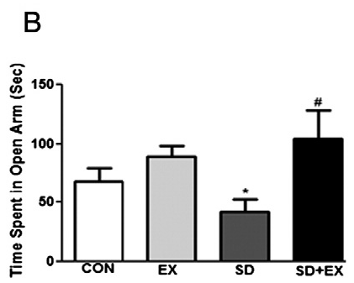
Treadmill exercise can rescue social defeat-induced anxiety-like behavior
G. Patki et al. / Physiology & Behavior 130 (2014) 135–144
Notes:
-

Slide 3
Hippocampus
Exercise and Stress affect the endocannabinoid system and GABAergic neurons in the hippocampus
Exercise
Stress
Endocannabinoid system
GABAergic neurons

Slide 4
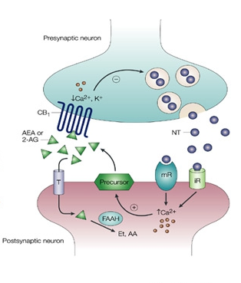
Endocannabinoid system
https://www.sclabs.com/the-endocannabinoid-system-and-stress-related-psychiatric-illness/

Slide 5
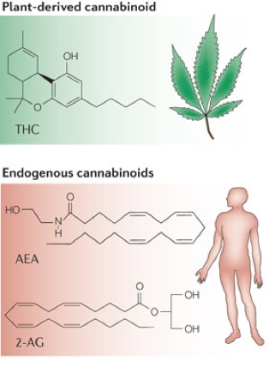
Endocannabinoids
https://www.sclabs.com/the-endocannabinoid-system-and-stress-related-psychiatric-illness/

Slide 6
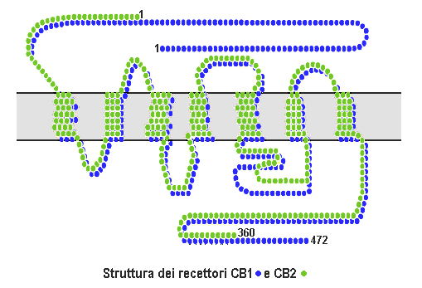
Endocannabinoid receptors
https://en.wikipedia.org/wiki/Cannabinoid_receptor#

Slide 7
Overexpression of CB2 cannabinoid receptors decreased vulnerability to anxiety and impaired anxiolytic action of alprazolam in mice
Marı´a S Garcı´a-Gutie´rrez and Jorge Manzanares
Journal of Psychopharmacology, 2011
25(1) 111–120

Slide 8
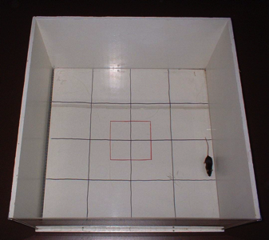
Open Field Test
http://biomed.au.dk/fileadmin/_migrated/pics/Open_field_SG.png

Slide 9
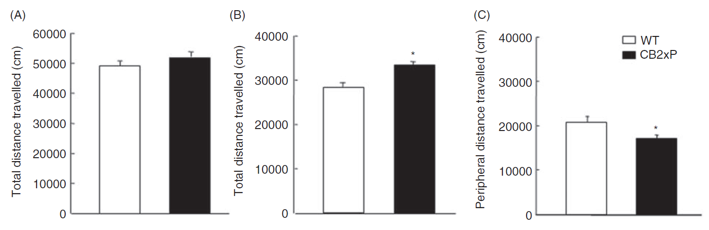
Cb2 gene overexpression leads to increase time spent in the center during open field test

Slide 10
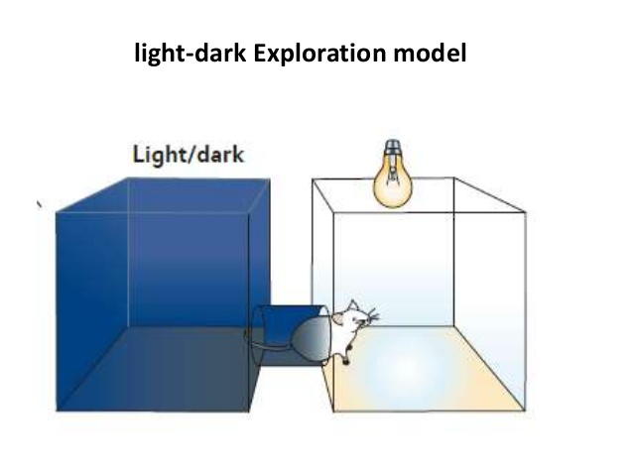
Light-dark Box test
https://image.slidesharecdn.com/screeningofanxiolytic-150210221920-conversion-gate02/95/screening-of-anxiolytics

Slide 11
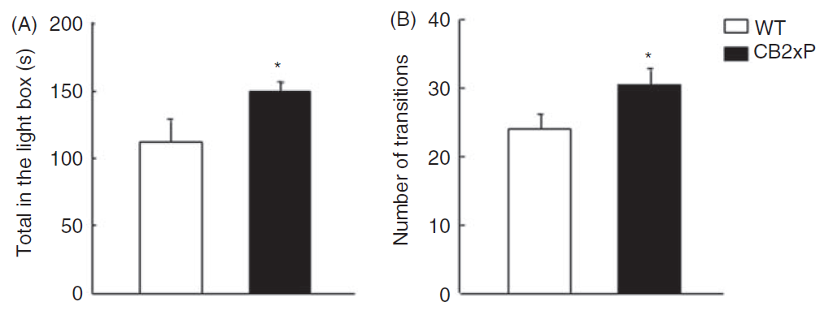
Cb2 gene overexpression leads to increase time spent in the light during light-dark box test

Slide 12
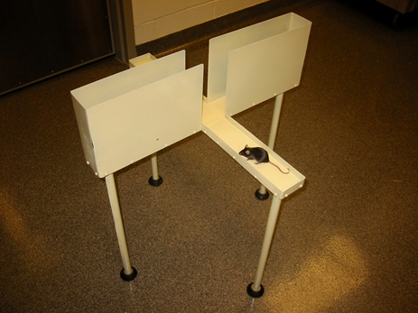
Elevated plus maze test
http://www.cidd.unc.edu/images/elevatedPlusMaze.jpg

Slide 13

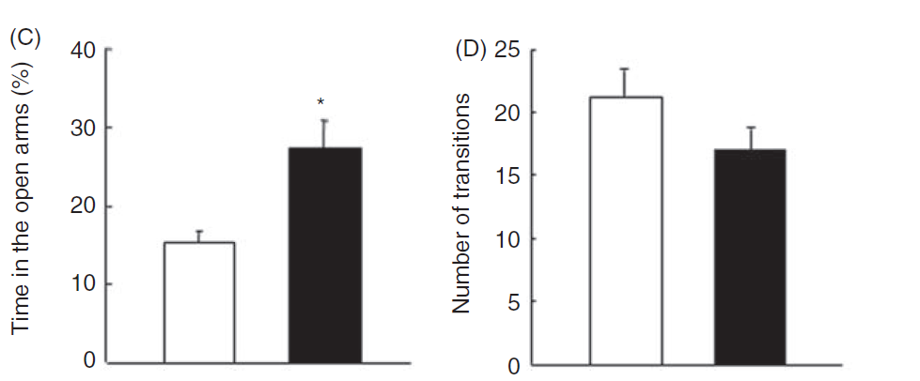
Cb2 gene overexpression leads to increase time spent in the open arm at elevated plus maze test

Slide 14
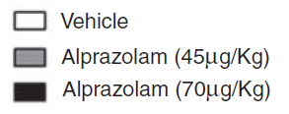

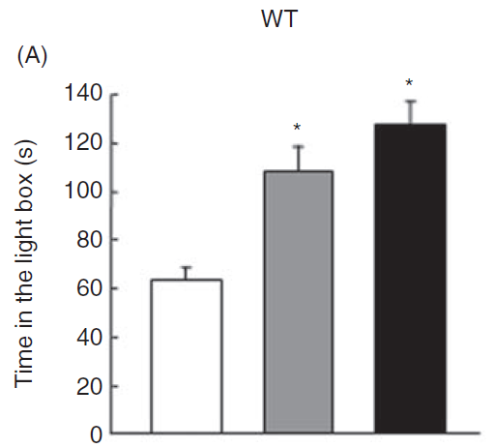
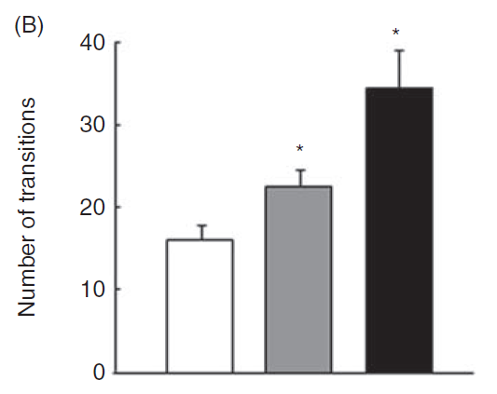
Alprazolam treatment increase time spent in the light during light-dark box test

Slide 15
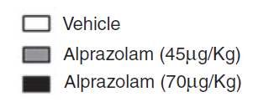
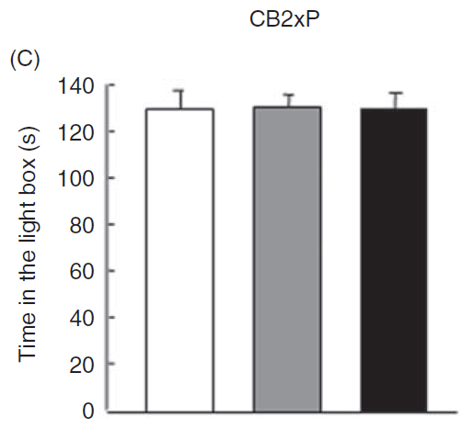
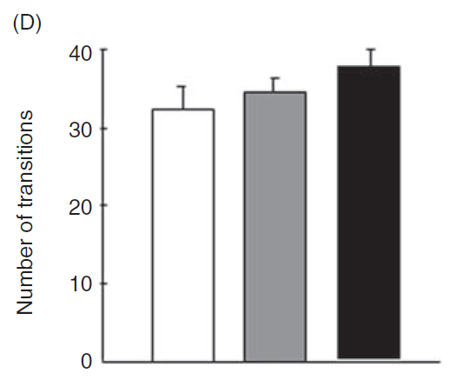
Alprazolam treatment has no effect on Cb2 overexpressing mice during light-dark box test

Slide 16

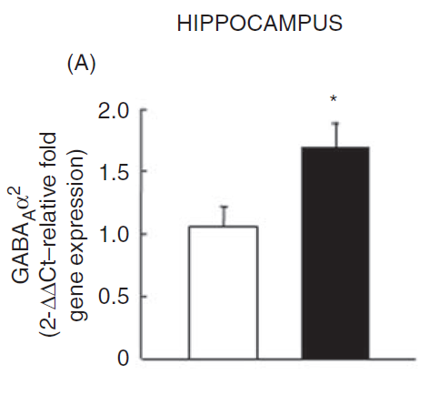

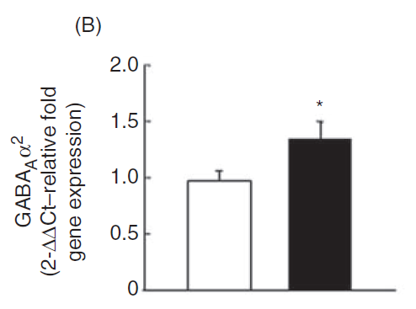
Increased expression of GABA receptors in Cb2 overexpressing mice

Slide 17
Summary:
Cb2 receptor overexpression has anxiolytic effects as it is evident from the open field test, light-dark box test and elevated plus maze test.
Cb2 receptor overexpression leads to increase in expression of GABAA receptors in hippocampus.

Slide 18
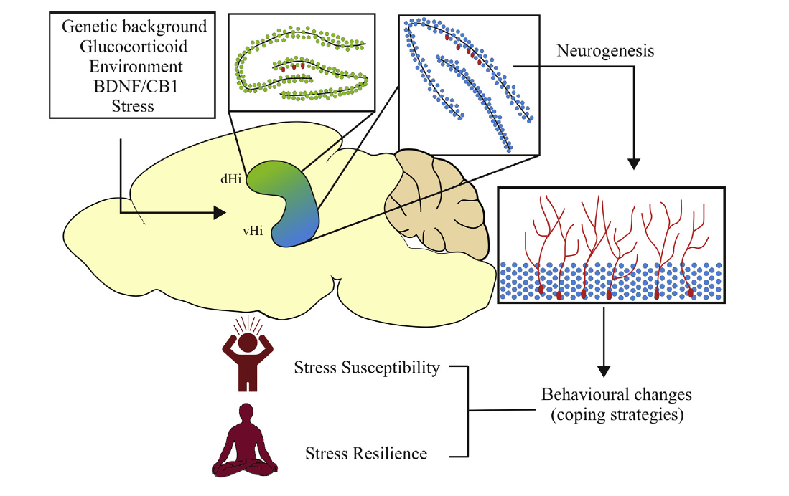
Different role of dorsal and ventral hippocampus
B.R. 152 Levone et al. / Neurobiology of Stress 1 (2015) 147e155

Slide 19
ANXIOUS BEHAVIOR INDUCES ELEVATED HIPPOCAMPAL Cb2 RECEPTOR GENE EXPRESSION
JAMES M. ROBERTSON, JUSTIN K. ACHUA, JUSTIN P. SMITH, MELISSA A. PRINCE, CLARISSA D. STATON, PATRICK J. RONAN, TANGI R. SUMMERS AND CLIFF H. SUMMERS
Neuroscience 352 (2017) 273–284

Slide 20
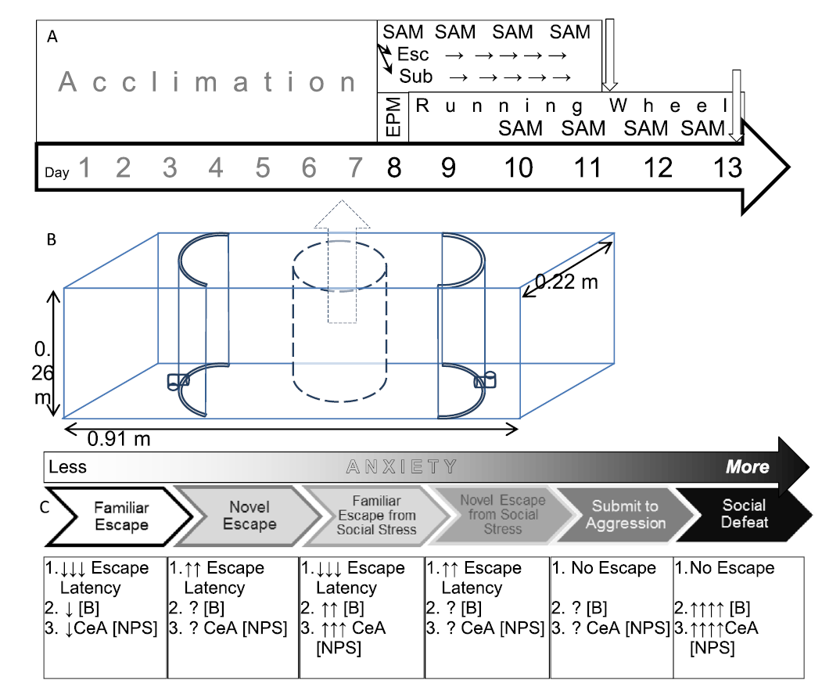
Stress-Alternatives Model (SAM)

Slide 21
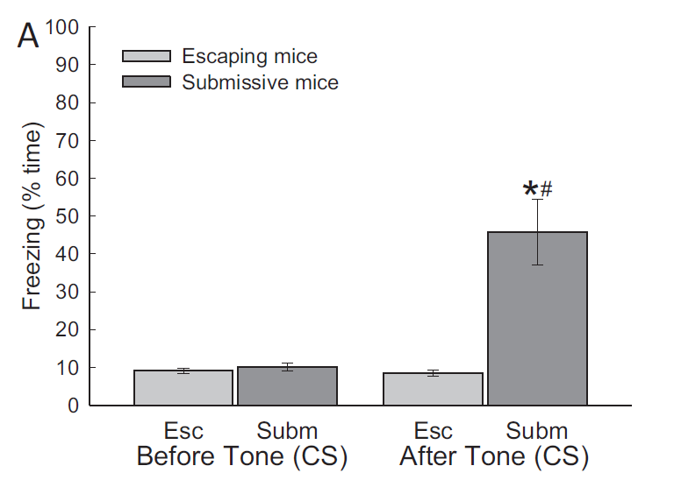
Freezing Time increased in submissive mice

Slide 22
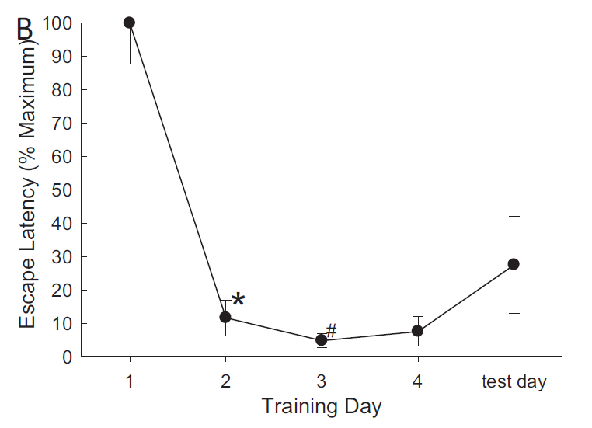
Escape latency decreased in escaping mice

Slide 23
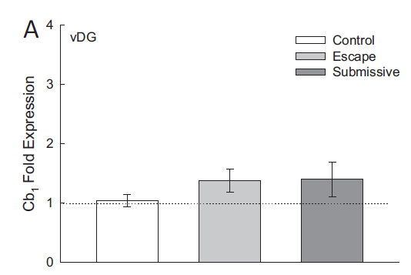
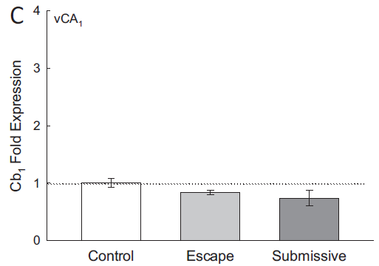
No effect on Cb1 receptor expression in ventral dentate gyrus and ventral CA₁ region of hippocampus

Slide 24

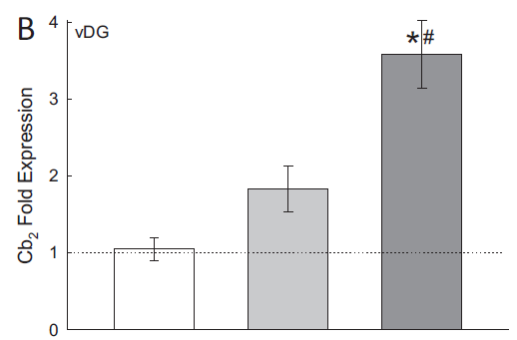
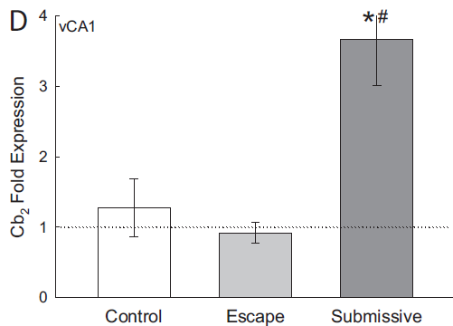
Cb2 receptor expression in ventral dentate gyrus and ventral CA₁ region of hippocampus increased

Slide 25
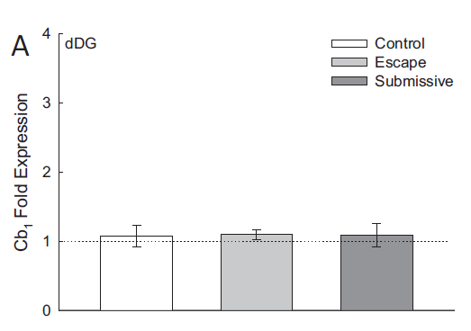
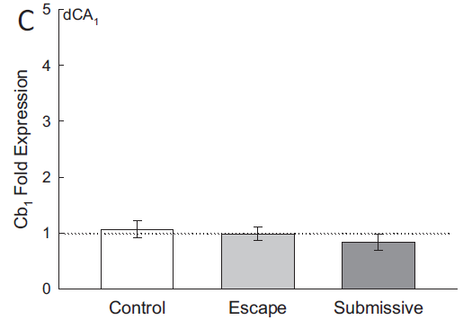
No effect on Cb1 receptor expression in dorsal dentate gyrus and dorsal CA₁ region of hippocampus

Slide 26

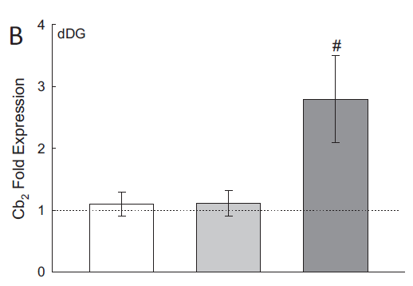
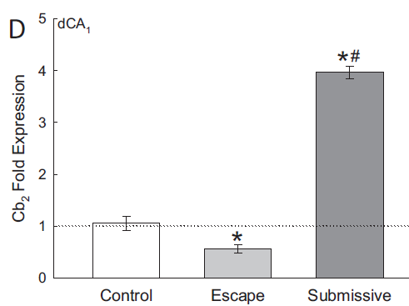
Cb2 receptor expression in dorsal dentate gyrus and dorsal CA₁ region of hippocampus increased

Slide 27
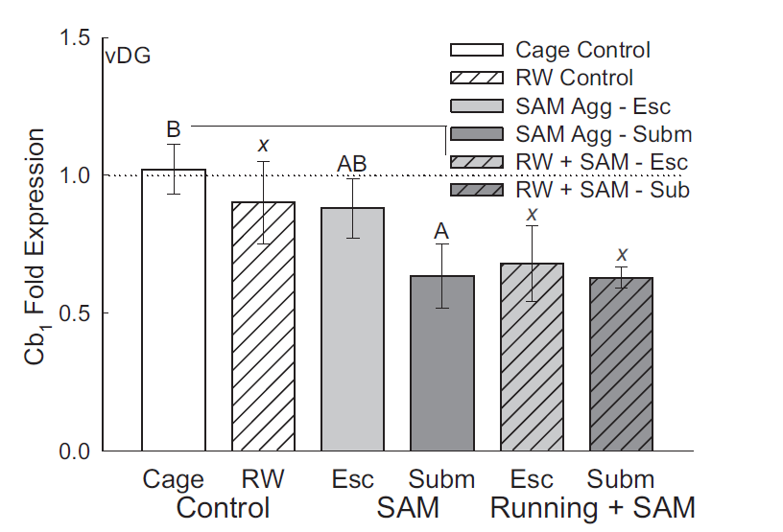
Exercise has no effect on Cb1 expression in ventral dentate gyrus region of mice which went through SAM social aggression

Slide 28
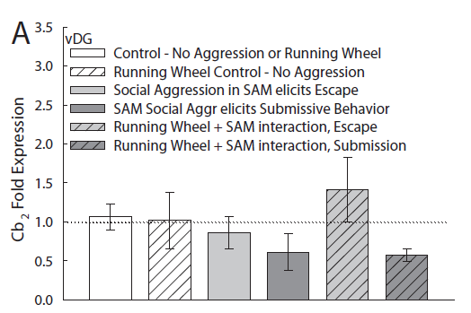
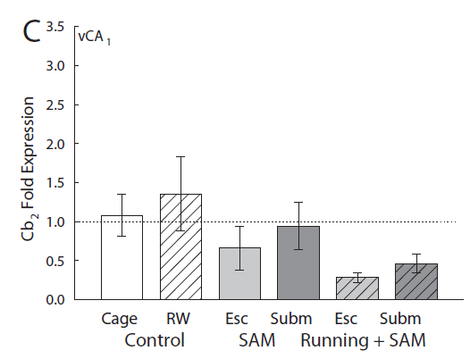

Exercise has no effect on Cb2 expression in ventral dentate gyrus and ventral CA1 region of mice which went through SAM social aggression

Slide 29
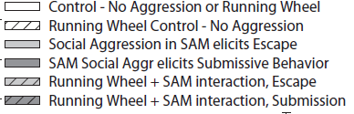
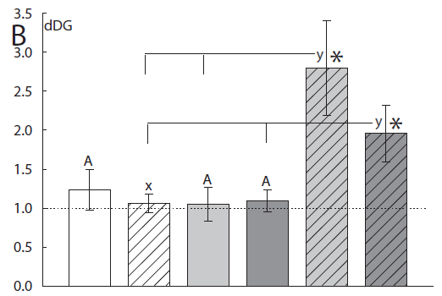
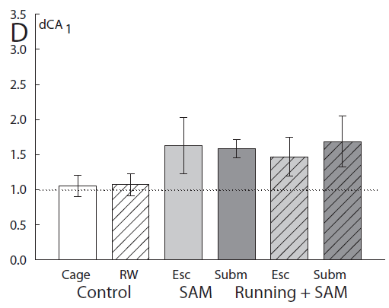

Exercise caused increased Cb2 expression in dorsal dentate gyrus but not dorsal CA1 region of mice which went through SAM social aggression

Slide 30
Summary:
There is increased expression of Cb2 receptors in ventral and dorsal dentate gyrus region of hippocampus in submissive mice which went through social defeat.
Running and Social defeat stress leads to increased expression of Cb2 receptors in dorsal dentate gyrus region of hippocampus in mice showing escape and submissive behavior.

Slide 31
Physical Exercise Prevents Stress-Induced Activation of Granule Neurons and Enhances Local Inhibitory
Mechanisms in the Dentate Gyrus
Timothy J. Schoenfeld, Pedro Rada, Pedro R. Pieruzzini,
Brian Hsueh, and Elizabeth Gould
The Journal of Neuroscience, May 1, 2013 • 33(18):7770 –7777

Slide 32
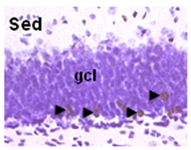
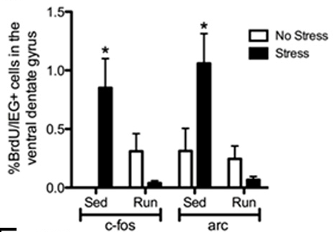
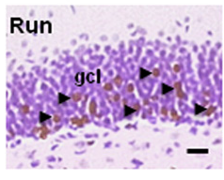
Running increased the number of newly formed neurons in the dentate gyrus of hippocampus

Slide 33
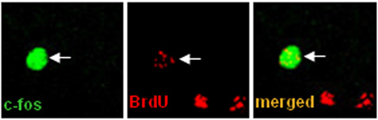
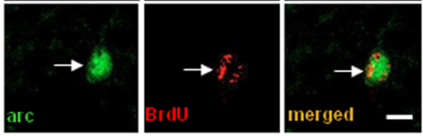
Running prevents activation of new neurons in the ventral dentate gyrus due to stress

Slide 34
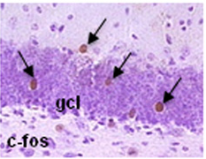
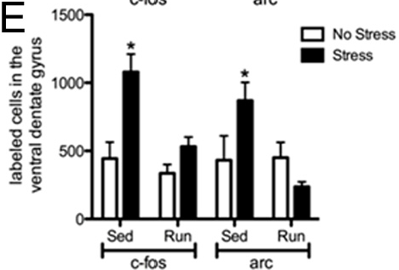
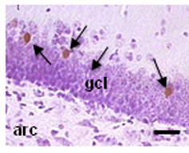
Running prevents activation of granule neurons in ventral dentate gyrus due to stress

Slide 35
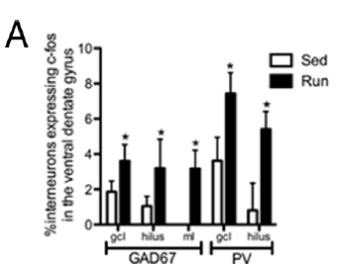
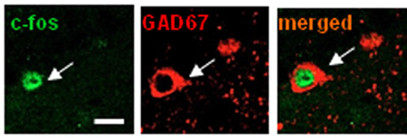
Interneurons in the ventral dentate gyrus shows increased activity to stress in runners as compared to sedentary mice

Slide 36
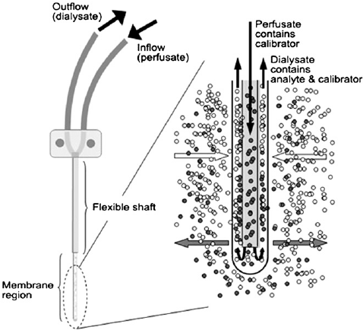
Microdialysis
https://www.researchgate.net/profile/Hartmut_Derendorf/publication/6369883/figure/fig1

Slide 37
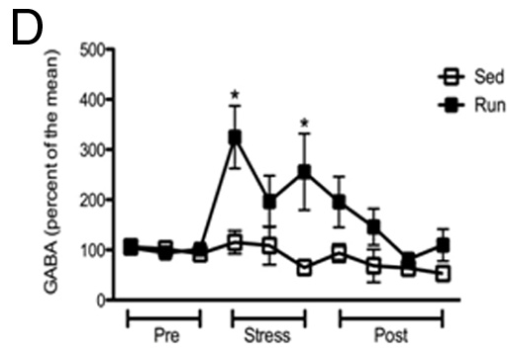
There was increase in extracellular GABA in ventral hippocampus in runners due to stress as compared to sedentary mice

Slide 38
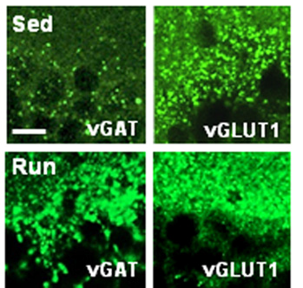

Increase in GABA receptor staining in ventral hippocampus in runners as compared to sedentary mice

Slide 39


GABA receptor antagonist Bicuculline when administered in ventral hippocampus caused decrease in time spent in open arms by the runners

Slide 40


Bicuculline doesn't cause any effect if the treatment was given in dorsal hippocampus in runners

Slide 41
Summary:
There was increase in extracellular GABA in ventral hippocampus in runners due to stress as compared to sedentary mice.
Increase in GABA receptor staining in ventral hippocampus in runners as compared to sedentary mice.

Slide 42
Conclusion

Slide 43

Endocannabinoid binding to the presynaptic site can lead to release of GABA
http://www.neurology.org/content/69/3/306/F1.large.jpg

Slide 44

GABAergic signaling in the hippocampus
Ge et.al, (2007)TRENDS in Neurosciences Vol.30 No.1

Slide 45
Hippocampus
Exercise and Stress affect the endocannabinoid system and GABAergic neurons in the hippocampus
Exercise
Stress
Endocannabinoid system
GABAergic signaling
Reduces the excitatory signals created due to Stress

